Slide 1
Data analysis
Project Name :- Super store Data
Present By :- Sonali M. Devikar

Slide 2
Introduction
The Project Is About The Analyzing Data Of Super Store
Deeply Analyze Sales Column With Other Related Column.
Which Helpful For Business Growth And Suggestion About Sales Increasing Strategy.

Slide 3
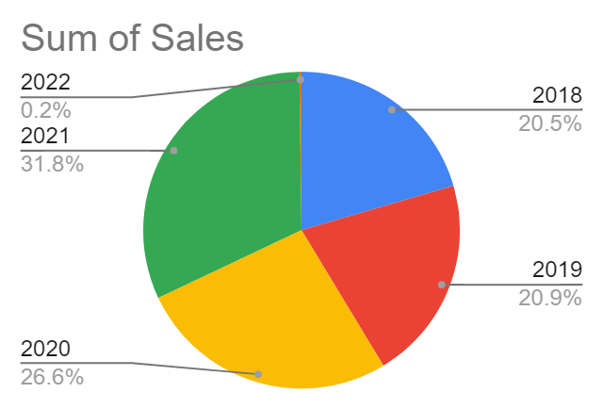
1.Shipping date wise sales

Slide 4
Analysis:-
As Per The Pie Chart We Are Analyzing The Sales In Last 4 Years. Between 2018 To 2019 The Sales Was Not Going On Well It Was Increased By 0.4%. About 2020 And 2021 The Sales Was Given A Good Performance It Was Increased By 5 To 6%.
Observation:-
Observation About Sales In Last Four Years, The Growth
Of Sales Was Quite Slow. The Percentage Of Increasing Sales Same As Previous Year.
Conclusion:-
We Need To Improve Sales Strategies And Focus On Sales Growth
By Increasing Its Percentage.
Suggestion:-
We Want To Add More Creativeness In Marketing Which Attracts
customers. Add Some Offers In Off Season. Achieving High Level Customer
Satisfaction.

Slide 5
2. Ship mode wise sales

Slide 6
Analysis:-
As Per The Above Graph Information Sales Of Standard Class Is High Difference Compare With Other Class. The Percentage Is 59% Of A Standard Class. First Class And Second Class Not Much Have Difference.
Observation:-
Same Day Delivery Percentage Is Very Low 5.6%. Customers Are Preferred The Standard Class.
Conclusion:-
We Need To Focused On Same Day Delivery And Other Class Also.
Suggestion:-
wants to give attention on product availability and transport
to improve same day delivery. add some employee to delivered products on time. create some advertisement on one day delivery to fill up the time demand.

Slide 7
3.segment wise sales

Slide 8
Analysis:-
As Per Segment Wise Sales Indicates The Consumer Part Is Very High Compare To Corporate And Home Office.
Observation:-
Segment Wise Sales The 70% Sales Are Come From Consumer And 20% From Corporate And Remaining 10% From Home Office.
Suggestion:-
We Need To Add Some Special Offers To Corporate Level.
Want To Create Additional Policies To Home Office.

Slide 9
4.City wise Sales

Slide 10
Analysis:-
As Per The Graph We Are Analyze Only 30% Of Total City Having A Maximize Sales Remaining 70% City's Are Minimal Sales.
Observation:-
We Need Promote Sales In Which City's Having Minimal Sales. The Scope Of Increasing Sales In Those City's Are High.
Suggestion:-
Need To Advance Advertisement, Study Of Product Demand In Particular Cities, Understand The Consumer Mind Set.

Slide 11
5.State wise sales

Slide 12
Analysis:-
State Wise Sales Analysis Are Indicates The 20% Of States Having A High Level Sales Compare The Other State.
Observation:-
Most of the states have a low range of sales. We need to study those states.
Suggestion:-
Find the consumer demands and wants. Need to understand the problems of sales in those states and create a problem solving statements.

Slide 13
6.Region wise Sales

Slide 14
Analysis:-
We Analyze That Sales Are Going Well In The East And West Regions. The Central Region Performed Quite Well, While The South Has A Low Percentage.
Observation:-
As Per Observation Need To Find Products Demand Of South Region And need to more impressive planning for sales.
Suggestion:-
For Improving Sales We Need To Expand Distribution Channels ,
products Innovation And Targeted Marketing Campaigns In South And Central Region.

Slide 15
7.Category wise Sales

Slide 16
Analysis:-
As per category-wise sales analysis, we have found that technology sales on 70%, furniture sales on 20%, and office supplies sales on 10%.
Observation:-
By observing this graph, we are able to understand that office supplies sales are very low, and consumers are attracted to new technologies.
Suggestion:-
We suggest, based on our analysis, adding more advanced options and new styles in furniture, For office supplies, we recommend visiting new offices with the marketing team to convince them about our products.

Slide 17
8.Presenting Sub Category Wise Sum Of Sales

Slide 18
Analysis:-
On the basis of the analysis, phone and chair sales are high compared to others. Arts, envelopes, fasteners, labels, and supplies have very low sales.
Accessories, appliances, binders, bookcases, copiers, furnishing machines, paper storage, and tables were quite good.
Observation:-
We need to focus on art, envelopes, fasteners, labels, and supplies
sales.
Suggestion:-
Add Some Art Related Advertisements With color full and attractive pictures . Add Some Offers On Fasteners Whole Kit Which Profitable To Both Seller And Buyer.

Slide 19
Suggestion For Over All Sales Analysis:-
As per this analysis we are suggest that give some beneficiary offers to sales team so they respond actively on the sales target.
Add special offers to attract the customers.
Which are the product in loss stop their selling because the sales of this products is already in loss if we stop selling the loss will stop and profit will increase automatically.
Increase supply of those products which is in good profit.
Present By Sonali M. Devikar

